Slide 1

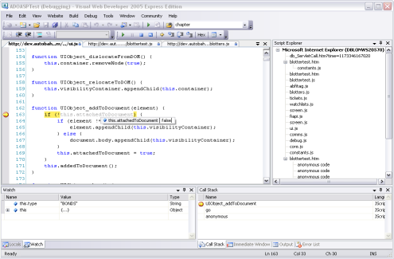

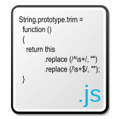

Prototypal Inheritance and Duck Typing
The way to create objects in JavaScript
JavaScript OOP
Telerik Software Academy
http://academy.telerik.com

Slide 2
Table of Contents
Object prototypes
"Inheriting" prototypes
Setting values on prototypes
Creating instances with Object.create()
Wrapping it into IIFEs
Duck typing

Slide 3
Object Prototypes

Slide 4
Object Prototypes
The prototype is an object, that provides properties to its inheritors
i.e. the objects that have this object as their prototype
Every object has its own prototype
By default, set to Object.prototype
This forms the so called "Prototype chain"
Object has for prototype null, ending the prototype chain

Slide 5
Object Prototypes: Example
Given the code:
var animal = {
/* properties and methods */
};
The prototype chain is:
animal
has prototype
Object.prototype
has prototype
null

Slide 6
Setting the Prototype of an Object
Every JavaScript object has a property __proto__
It can be used to access/change the prototype
Dangerous to use
When setting a prototype to an object, the object has access to all the properties of the prototype
Through the prototype chain
This is actually called Prototypal Inheritance
var animal = {
makeNoise: function(){
console.log('The ' + this.type + ' makes noise "' + this.noise + '"');
}
};
var dog = { type: 'dog', noise: 'Djaf' };
dog.__proto__ = animal;
dog.makeNoise(); // makeNoise() is from the prototype(animal)

Slide 7
Setting the Prototype of an Object
var animal = {
makeNoise: function(){
console.log('The ' + this.type + ' makes noise "' + this.noise + '"');
}
};
var dog = { type: 'dog', noise: 'Djaf' };
dog.__proto__ = animal;
dog.makeNoise(); // makeNoise() is from the prototype(animal)
dog
has prototype
animal
has prototype
Object.prototype
has prototype
null

Slide 8
Setting the Prototype with __proto__
Live Demo

Slide 9
Setting Prototypes with Object.create()
The better way to work with prototypes

Slide 10
Setting Prototypes with Object.create()
ES5 introduces a method for setting the prototype of an object
Object.create(object)
var animal = {
/* properties and methods */
};
var dog = Object.create(animal);
dog.type = 'dog';
dog.noise = 'djaf';
var animal = {
/* properties and methods */
};
var dog = {
type: 'dog',
noise: 'djaf'
};
Dog.__proto__ = animal
Same as

Slide 11
Setting Prototypes with Object.create()
Live Demo

Slide 12
Working with Object Prototypes
Object.create() is great, but it is kind of sloppy to set properties with dot (.)
This all can be solved with Object.defineProperties():
var dog = Object.defineProperties(animal, {
type: {
value: 'dog'
},
noise: {
value: 'djaf'
},
bark: {
value: function (){
console.log('Bark, Bark');
}
}
});
return dog;
});

Slide 13
Working with Object Prototypes (2)
And… there are IIFEs:
var dog = (function (parent) {
var dog;
/* hidden methods */
dog = Object.defineProperties(parent, {
type: {
value: 'dog'
},
noise: {
value: 'djaf'
},
bark: {
value: function (){
console.log('Bark, Bark');
}
}
});
return dog;
});

Slide 14
Working with Object Prototypes (2)
Live Demo

Slide 15
Reusing Parent Methods

Slide 16
Reusing Parent Methods
Reusing parent methods is crucial to any object-oriented design
Thankfully there are Function.prototype.call() and Function.prototype.apply()
var animal = /* declare and return animal */
var dog = (function(parent){
var dog = Object.create(parent);
Object.defineProperty(dog, 'init', {
value: function(name, age, breed){
parent.init.call(this, name, age);
this.breed = breed;
}
});
return dog;
}(animal));

Slide 17
Reusing Parent Methods
Live Demo

Slide 18
Duck Typing

Slide 19
Duck Typing
Duck typing is a layer of programming language and design rules on top of typing
Typing is concerned with assigning a type to any object
i.e. methods work with object of some type
Duck typing is concerned with establishing the suitability of an object for some purpose
i.e. methods with object that have certain properties

Slide 20
Duck Typing Examples
Using Array#slice
Methods does not care of the type of the passed objects
var arrObj = {
length: 3,
'0': 'One',
'1':'Two',
'2': 'Three'
};
var arr = [].slice.call(arrObj);
//returns ['One', 'Two', 'Three']
With our objects
var person = {
name: 'John Doe', age: 0,
introduce: function () {
console.log('Hello! I am ' + this.name + ' and I am ' + this.age + '-years-old');
}
};
person.introduce;
person.introduce.call({ name: 'Snoopy', age: 2 });

Slide 21
Duck Typing
Live Demo

Slide 22
Prototypal Inheritance and Duck Typing
http://academy.telerik.com

